Slide 1
KINNERET COLLEGE
The Water Industry Engineering Department

Slide 2
Table of contents
The Kinneret academic college: School of Engineering
The school of engineering and the department of Water Industry Engineering
Water technology Projects: 3 examples

Slide 3
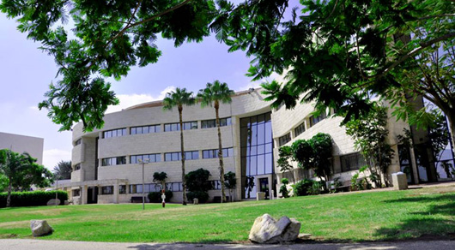
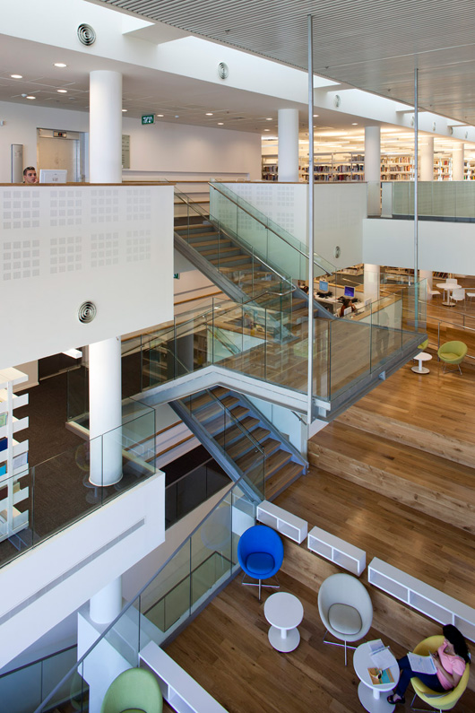
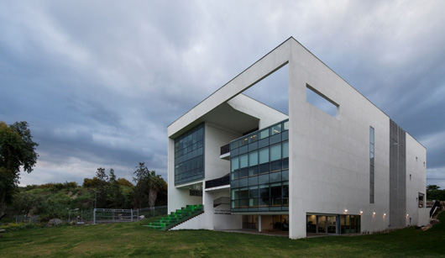
The Kinneret academic college
Established in 1965 as a regional college. In 2011, received a certificate of recognition from former President of Israel, Shimon Peres
Today, Kinneret Academic College offers B.A and B.Sc. degrees within the framework of two schools: School of Humanities and Social Sciences, and Achi Racov School of Engineering
Achi Racov School of Engineering B.Sc. Is comprised from 5 academic departments:
Water Industry Engineering (the largest pne in the school and in Israel)
Electronic Engineering
Software Engineering
Quality and Reliability Control Engineering
Gas and Petroleum Energy Engineering

Slide 4
The department of Water Industry Engineering (WIE)
Began Operating in October 2010. Headed by Prof. Ram Shpiner, a PhD holder from the esteemed Chemical Engineering Department of the Imperial College, London
Currently, around 160 students study in the program- making it the largest department in the school and the largest department related to water engineering in Israel
A balanced blend of practical and theoretical studies, preparing high level engineers for the rapidly developing water industry, both in Israel and abroad
ram.shpiner@gmail.com

Slide 5
Water technology Projects: Some success cases
Every year about 10 applied research projects are run in the department regarding water and wastewater technologies, some of which may be implemented in the hotel industry
A short list of those projects include :
The use of brine electrolysis for the production of chlorine for disinfection
The use of new granular median for filtration
The use of composite material for the adsorption of organic compounds from water
The use of algae produced oxygen for small wastewater treatment plant
Economical irrigation projects by drip irrigation

Slide 6
Water technology Projects: Some success cases : Advanced water treatment
Some examples of technologies studied un the WIE department that can be implemented in the hotel industry :
A : Advanced water treatment processes for the removal of particles and organics
Technology components : A new granular media for rapid sand filtration and composite material (including nanoparticles) for the adsorption of organic compounds
Potential use and savings : recycle of swimming pool water – decrease in freshwater consumption

Slide 7
Water technology Projects: Some success cases : Drip Irrigation
B : Use of advances irrigation system - decrease of water consumption for gardening
Technology components : Innovative and precise irrigation are common practice in Israeli agriculture. The technologies are aimed to supply the plants exactly what they need and decrease water loos due to aerosols and evaporation
Potential use and savings : Smart irrigation will decrease water consumption in gardening in medium sized hotels

Slide 8
Water technology Projects: Some success cases : Effective pumping systems
C : Use of smart pumping systems working at high efficiencies - decrease of energy consumption
Technology components : Understanding of the pumping systems in the hotel and designing a smart control tool that optimises the operation of the various pumps
Potential use and savings : Cooling systems, pools and all pumping bases systems in the hotel industry

Slide 9
MANY THANKS!

