Slide 1




Tex-Med Clusters project:
A pathway to the Mediterranean T/C Hyper-Cluster
Francesco Pellizzari –Technical Assistance Manager
Capitalization Forum, Alexandria 1st December 2015
1

Slide 2



1. Approach
Capitalization Forum, Alexandria 1st December 2015

Slide 3
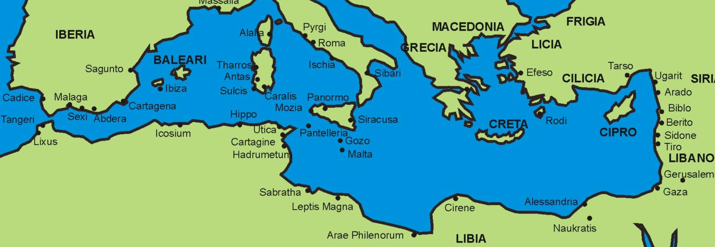
The starting model.
Russia
Subcontracting and Delocalization
Capitalization Forum, Alexandria 1st December 2015

Slide 4

The targeted model.
Co-contracting and Multilocalization
The Mediterranean T/C Hypercluster
Capitalization Forum, Alexandria 1st December 2015

Slide 5
The Ultimate Goal:
Global Competitiveness.
Northern
Europe
Russia
China
East Asia
USA
The Gulf
Latin
America
Africa
Capitalization Forum, Alexandria 1st December 2015

Slide 6
The pathway
Subcontracting
Delocalization
Cocontracting
Multilocalization
Biggest Issue
TEX-MED
CLUSTERS
The Mediterranean T/C
Hyper-cluster
Northern
Europe
Russia
China
East Asia
Ultimate goal of
Tex-Med Clusters
USA
Challenge:
Global Competitiveness of
Mediterranean T/C Industry
Latin
America
Africa
The Gulf
Capitalization Forum, Alexandria 1st December 2015

Slide 7
2. Methodology for Assessment of the Clusters
Capitalization Forum, Alexandria 1st December 2015

Slide 8
SMEs Business Models.
Capitalization Forum, Alexandria 1st December 2015

Slide 9
The eight value chains.
Fiber
Prep
Add Value
Wet/Finish
CMT
Conf.
Final mkt Retail
Yarns
Fabrics
PRATO
SABADELL
THESSALON.
CO
TUNISIA T/C
TUNISIA TT
ALEXANDRIA
BETHLEHEM
AMMAN
Capitalization Forum, Alexandria 1st December 2015

Slide 10
Clusters Specializations.
 | Mach. Tech. | Software NewTec | Raw Mat Fibre | Yarns | Weaving Knitting | Dying Finishing | Techn Textiles | Confec. | Brands Retail | Export
Prato IT | ** | * |  | *** | *** | **** | ** | * | ** | ***
Sabad. SP | ** | ** |  | * | ** | ** | *** | *** | ** | ***
Thess. GR |  | ** | ** | * | *** | ** | * | *** | ** | ***
Tun. Conf. |  |  |  |  | ** | * |  | **** | ** | **
Tun. TT |  |  |  |  | * | ** | *** | **** | ** | *
Alex EG |  |  | ** | * | ** | * |  | **** | * | *
Palestine |  |  |  |  |  |  |  | *** |  | **
Jordan |  |  |  |  |  | * |  | **** |  | ****
 |  | strong specialization |  |  |  |  | good specialization
Capitalization Forum, Alexandria 1st December 2015

Slide 11
Integration of the value chains.
1
2
3
4
5
6
7
8
One Macro Mediterranean Value Chain
Capitalization Forum, Alexandria 1st December 2015

Slide 12
3. The ENPI Programme
Strategic Actions
Capitalization Forum, Alexandria 1st December 2015

Slide 13
Cross Border Cooperation Initiatives.
Innovation &Tech-textiles
EU programs for Innovation
Technical textiles
Recycled Cotton
Brands & Business Models
Development of Local Brands
From Subcontracting to Co-contracting
Market Development
International development
Operations
Stock (leftovers) Management
Capitalization Forum, Alexandria 1st December 2015

Slide 14
4. Project tools for
CBC Initiatives
Capitalization Forum, Alexandria 1st December 2015

Slide 15
Tex-Med Clusters development.
ASSESSEMENT
I M P L E M E N T A T I O N
PREPARATION
CAPITALIZATION
KICK OFF
WRAP
UP
CLUS
CONF
SMEs
CONF
CAP FORUM
*
*
*
*
*
*
*
*
*
*
ITMA
TECHTEXTILES
WS ATHENS
WS MONASTIR
WS DEAD SEA
INNOVATION DAY
STOCK INITIATIVE
*
MATCH MAKING
MEETINGS
Capitalization Forum, Alexandria 1st December 2015

Slide 16
Actions (Project implementation).
3 Workshops in order to raise awareness on critical issues as well as to frame the CBC partnerships into a consistent context.
10 Match-Making meetings in order to make easier the identification of CBC Initiatives coming up from needs and ideas of SMEs (bottom-up approach).
2 Joint Practical Activities in the area of innovation (such as: preparation of proposals, visits to leading fairs)
Capitalization Forum, Alexandria 1st December 2015

Slide 17
5. Tex-Med Clusters
Project Legacy
Capitalization Forum, Alexandria 1st December 2015

Slide 18
Lessons learned.
Cross border partnerships cannot be built up without a shared vision, an outlined strategy and a conceptual framework to refer to.
There is not long-lasting cooperation without a robust and comprehensive model. The mix of conceptual and practical activities of the Tex-Med Clusters Project demonstrated to be appropriate.
2. Much time is needed to share up a vision, identify common goals and build up an accepted approach.
From now on the project could full express the potential so far built to achieve major operational results.
Capitalization Forum, Alexandria 1st December 2015

Slide 19
Capitalization.
Widespread Awareness about the emerging T/C industry.
The educational/training approach greatly upgraded the awareness of SMEs about the future development of the industry.
Networking/Personal and Institutional relationships.
A strong network of relationships ensures cooperation among clusters beyond the duration of the project.
New Assets for Cooperation.
  A remarkable “project know-how reservoir” of methods and models
  Four permanent partnership agreements among PPs.
  Eight “Mediterranean desks”
  A working network of professional relationships.
“Idea of Partnerships” “Spirit of Partnerships”
Capitalization Forum, Alexandria 1st December 2015

Slide 20
Next Steps.
The next steps should target two main objectives:
Exert new joint efforts to access and penetrate international markets : Northern Europe, USA, Russia, the Gulf, Africa ....
2. Complete the work by taking into considerations areas of CBC Initiatives that were considered of second priority.
C09: Style and Performance.
C08: Islamic fashion.
D12: e-commerce
D13: e-Platform for raw materials
A03: e- Platform for technical textiles
A04: Improvement of Mediterranean Cotton, grown or recycled
Capitalization Forum, Alexandria 1st December 2015
20

Slide 21
Thank You.
For Contacts after the end of Tex-Med Clusters:
Francesco Pellizzari
fpellizzari@pensieroinnovativo.it
+39 335 6940 586
Capitalization Forum, Alexandria 1st December 2015
21

Slide 22
Disclaimer
The 2007-2013 ENPI CBC Mediterranean Sea Basin Programme is a multilateral Cross-Border Cooperation initiative funded by the European Neighbourhood and Partnership Instrument (ENPI). The Programme objective is to promote the sustainable and harmonious cooperation process at the Mediterranean Basin level by dealing with the common challenges and enhancing its endogenous potential. It finances cooperation projects as a contribution to the economic, social, environmental and cultural development of the Mediterranean region. The following 14 countries participate in the Programme: Cyprus, Egypt, France, Greece, Israel, Italy, Jordan, Lebanon, Malta, Palestine, Portugal, Spain, Syria (participation currently suspended), Tunisia. The Joint Managing Authority (JMA) is the Autonomous Region of Sardinia (Italy). Official Programme languages are Arabic, English and French (www.enpicbcmed.eu).
This presentation has been produced with the financial assistance of the European Union under the ENPI CBC Mediterranean Sea Basin Programme. The content of this document are the sole responsibility of UIP and can under no circumstances be regarded as reflecting the position of the European Union or of the Programme’s management structures.
Milan, 17 November 2015

