Slide 1
The Mediterranean Hyper-Cluster: Inputs for the CBC Initiatives
Francesco Pellizzari –Technical Assistance Manager
CBC Cluster Conference
Tunis, 17th Oct. 2014

Slide 2
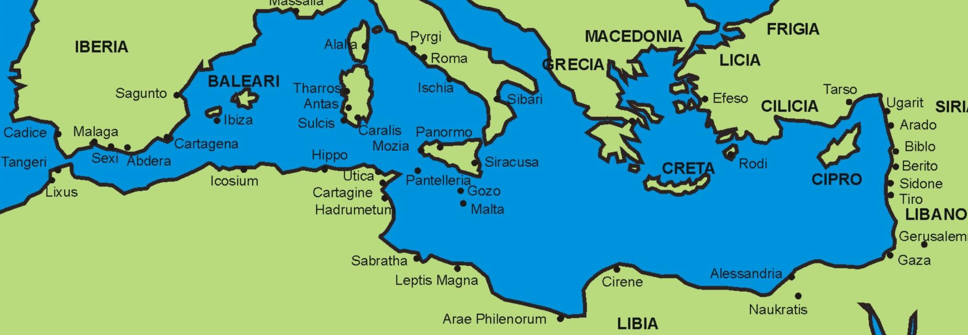
Our Final Goal: Strengthen inside to Compete outside
Russia
Russia
Northern
Europe
China
East Asia
USA
The Gulf
Latin
America
Africa
Tunis, 17th Oct. 2014

Slide 3
Project development
OUTPUTS FOR
EACH CLUSTER
OUTPUT:
THE TEX-MED
«HYPER-CLUSTER»
INPUTS
CURRENT
ACHIEVEMENT
Data Collection
On site visits
Survey
(270 companies)
Profile
(size, products,
value chains,…)
Characterization
(competences,
business models)
SWOT Analysis
Needs/Offers
Diversities and
Complementarities
Value Chains
Business Models
Segments and Markets
SWOT Analysis
Identification of 14
Areas of potential
CBC Initiatives for
Cluster Institutions
(Innovation)
Tunis, 17th Oct. 2014

Slide 4
The Eight value chains
Fiber
Prep
Add Value
Wet/Finish
CMT
Conf.
Final mkt Retail
Yarns
Fabrics
PRATO
SABADELL
THESSALON.
CO
T/C CETTEX
TECH/MFCPOLE
ALEXANDRIA
BETHLEHEM
AMMAN
Tunis, 17th Oct. 2014

Slide 5
Prevailing Business Models
Foreign
Owned
Sub-contr.
For Outside
Sub-contr.
For Inside
Internat.
Co- contr.
Brands
Own Prod.
Hybrids
PRATO
SABADELL
THESSALON.
T/C CETTEX
TECH/MFCPOLE
ALEXANDRIA
BETHLEHEM
AMMAN
Tunis, 17th Oct. 2014

Slide 6
Prevailing Segments
Fashion
Brands
Standard
Wear
Casual
Pr. Labels
Functional
Niches
Technical. Textiles.
Home
PRATO
SABADELL
THESSALON.
T/C CETTEX
TECH/MFCPOLE
ALEXANDRIA
BETHLEHEM
AMMAN
Tunis, 17th Oct. 2014

Slide 7
The Med Hyper-Cluster SW Analysis
Strengths | Weaknesses
Full coverage of the whole T/C value chain. Many and diversified excellences: Cotton production Fashion Manufacturing Widespread Entrepreneurship Brand Positioning (partial) Retail (partial) | Conflicting interests Weaker knowledge (compared to North EU and other advanced countries) on Technical Textiles. Unbalanced and overall “low” effort for R&D in the scientific and technical fields. Average small size of enterprises (with exceptions) Widespread subcontracting (SMEs “trapped”)
Tunis, 17th Oct. 2014

Slide 8
The Med Hyper-Cluster OT analisys
Opportunities | Threats
A global re-balancing of cost-competitiveness among countries The economic development of nearby countries (Africa) Emergence of a fashion alternative to the western one. The enhancement of cooperation and integration among Mediterranean partners. | Political Instability of the Middle East and stabilization in North Africa (MENA) The asymmetric position of Turkey Economic depression and adverse financial constrains in the Med EU countries (austerity, fiscal compact) Likely difficulties to keep pace technical innovation in comparison with other EU or Asian competitors.
Tunis, 17th Oct. 2014

Slide 9
The Mediterranean Hyper-Cluster
Take advantage of diversification for fortification.
Work hard to enhance a modern T/C Med Cluster
Tunis, 17th Oct. 2014

Slide 10
The Diamonds for CBC Initiatives
CBC Initiatives aiming at:
Implement common assets/operations/methodologies for: product R&D, energy, environment, training ….
Strengthen/share new process (management/organization)
Develop and sell new products (co-developed)
Set up new (renewed) marketing assets (such as: exhibition, common brands).
In order to increase the individual as well as overall competitiveness of the Mediterranean T/C Clusters in the Global market. Penetrate new markets.
Tunis, 17th Oct. 2014

Slide 11
Areas of CBC Initiatives
Technology and Product development
A2. Finishing/Water Treatment and Recycling
A3. Technical textiles
A4. Cotton Improvement. Techno-cotton-Organic-Recycled
Market Development
B5. Access the USA/Canada Markets
B6. International development
D11. (Inform for) Co-contracting
D12. E-commerce
Style & Design Innovation
C8. “Islamic” Fashion
C9. Style and product performance
C10. Development/Support of Local Brands
Management
E15 Young Entrepreneurs
E 16 HR Development
B7. Buffer Warehouse in Strategic Markets
F16. Stock (leftovers) Management
Tunis, 17th Oct. 2014

Slide 12
Good Luck & Keep Going
Tunis, 17th Oct. 2014

Slide 13
Disclaimer
The 2007-2013 ENPI CBC Mediterranean Sea Basin Programme is a multilateral Cross-Border Cooperation initiative funded by the European Neighbourhood and Partnership Instrument (ENPI). The Programme objective is to promote the sustainable and harmonious cooperation process at the Mediterranean Basin level by dealing with the common challenges and enhancing its endogenous potential. It finances cooperation projects as a contribution to the economic, social, environmental and cultural development of the Mediterranean region. The following 14 countries participate in the Programme: Cyprus, Egypt, France, Greece, Israel, Italy, Jordan, Lebanon, Malta, Palestine, Portugal, Spain, Syria (participation currently suspended), Tunisia. The Joint Managing Authority (JMA) is the Autonomous Region of Sardinia (Italy). Official Programme languages are Arabic, English and French (www.enpicbcmed.eu).
This presentation has been produced with the financial assistance of the European Union under the ENPI CBC Mediterranean Sea Basin Programme. The content of this document are the sole responsibility of UIP and can under no circumstances be regarded as reflecting the position of the European Union or of the Programme’s management structures.
Tunis, 17th Oct. 2014

