Slide 1
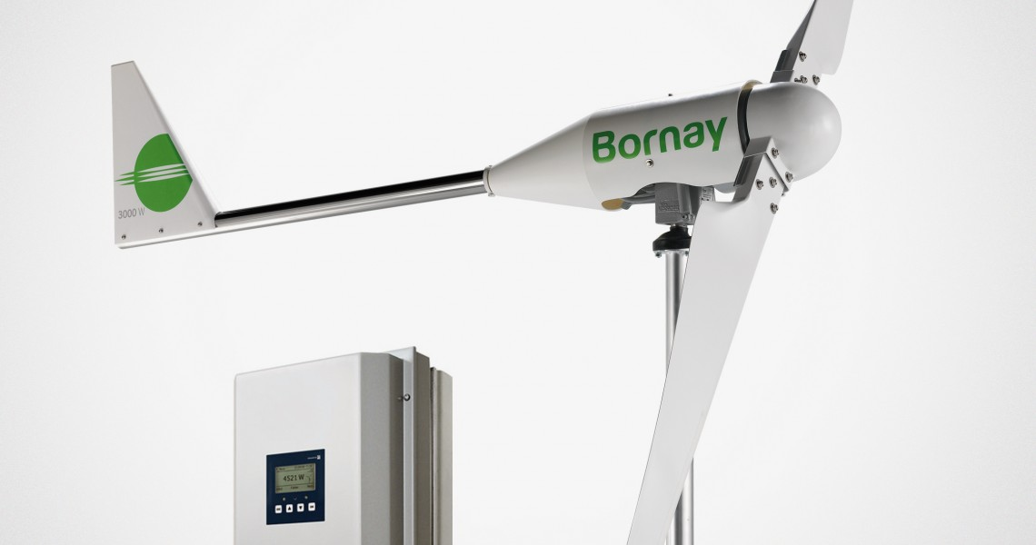
Wind power
Microeolic
Energy Saving
Wind power generation for use in individual installations can be considered to have an installed power of less than 100 kW, although there is no well defined limit. Smaller and easier to install, micro wind turbines present technical advantages when compared to its larger counterpart such as reduced noise, attractive aesthetics and localized power generation. Generators can be horizontal or vertical axis. Its application can be off grid with batteries (isolated areas, not connected to the grid) or grid connected and it is usually used in combination with other renewable energy sources, such as photovoltaic. Depending on its size, the wind turbine can be installed on the roof or on the ground.
Wind turbine BORNAY - 3 kW
Potential Use in Hotel Industry
Can be used in isolated areas
Complement to other energy sources (e.g. PV)
Can permanently power small household appliances, lighting pumping equipment, etc.
Disadvantages | Advantages
It cannot be installed in any geographical area | Substantial energy savings
Initial costs can be high | May be independent of electrical grid
Wind energy availability in urban areas is harder to predict | Their lightweight and small structure offer the possibility to be installed on roofs, or on the ground and be part of the urban landscape

