Slide 1
SESSION 2: Adventure Tourism Marketing Practices
Barbara Fritz
CEO AGEG Tourism for Sustainability
Ieva Zamaraite AGEG Tourism for Sustainability

Slide 2
8 SUSTAINABLE MARKETING PRACTICES

Slide 3
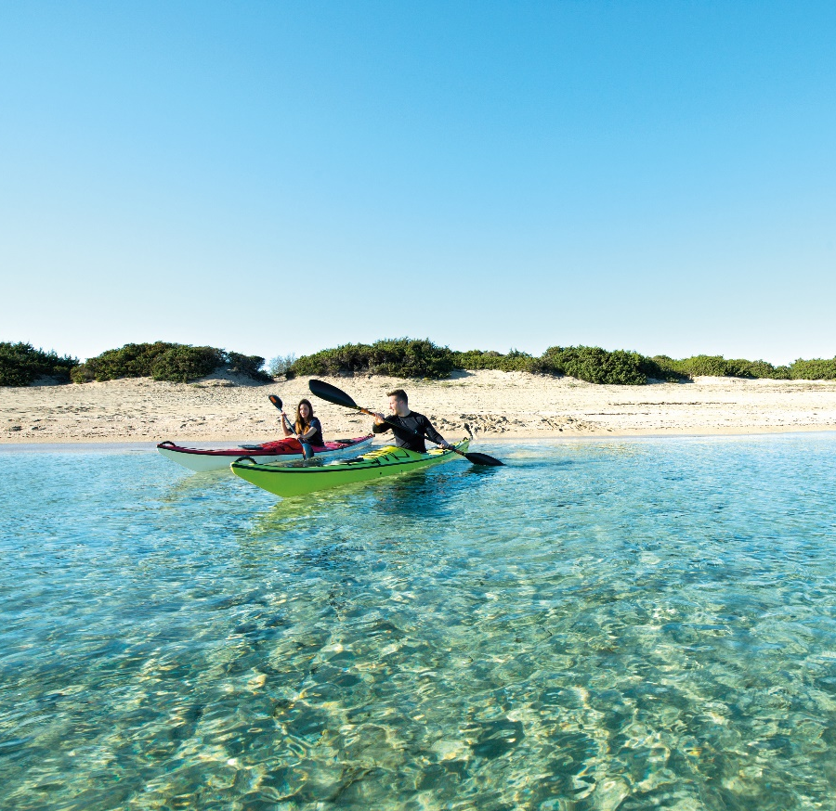
8 Sustainable Marketing Practices
The OVERVIEW
Using clients‘ reviews as promotional tool
Using storytelling for creative marketing campaigns
Joint branding and direct market access via targeted cooperation
Marketing through personal stories of local hosts
Use social media for direct market access
Marketing tours on specialized travel media
Umbrella organization for joint brand marketing: sustainable destinations – slow motion
Establishing local Partners network and joint branding, strong market positioning

Slide 4
Practice No. 1: WILDERNESS SCOTLAND
Using clients‘ reviews as promotional tool
This company offers a wide range of adventure holidays and wilderness experiences in the most remote regions of the Highlands and Islands of Scotland.
Twice winner of the Best Green Tour Operator in the World Travel Awards.
More than 5000 reviews with average rating of 4.88 out of 5.
https://www.wildernessscotland.com/
Notes:
This company offers a wide range of adventure holidays and wilderness experiences in the most remote regions of the Highlands and Islands of Scotland.
Among the activities offered, there are walking, cycling and mountain biking, sea kayaking, canoeing or photography tours.
Wilderness Scotland is Twice winner of the Best Green Tour Operator in the World Travel Awards.
They also run a carbon labelling project to calculate the kg of carbon per traveller, they collect funds for different conservation initiatives and more.
This practice is an example for Using clients‘ reviews as promotional tool
Currently they have More than 5000 reviews with average rating of 4.88 out of 5

Slide 5
Marketing Approach
Every client receives a feedback survey when they return from their guided, self-guided or tailor-made holiday with Wilderness Scotland.
Clients’ reviews displayed on central places of the website, including on the top of the homepage.
Great resource for future clients to check what other travellers from different countries and age groups enjoyed and why and filter reviews according to the type of the trip!
Notes:
The have a system to collect the reviews - Every client receives a feedback survey when they return from their guided, self-guided or tailor-made holiday with Wilderness Scotland.
They showcase clients’ reviews on central places of the website, including on the top of the homepage. It is the first think one sees on their website
Plus, they have a whole page with reviews. It serves as a great resource for future clients to check what other travellers from different countries and age groups enjoyed and why and filter reviews according to the type of the trip!

Slide 6
Practice No. 2: ACTIVE ALBANIA
Using storytelling for creative marketing campaigns
Responsible tour operator for adventure activities from rafting to cycling in Albania and neighboring countries.
Works with small local businesses offering genuine hospitality and authenticity of small, often family-run accommodation.
More than 450.000 views on YouTube of their ‘Taken by Albania’ campaign video.
https://www.activealbania.com/
Notes:
Active Albania is a responsible tour operator based in Tirana, Albania’s capital, which runs tours around the country and its neighbours.
They have a great offer of adventure tours on land and on water – hiking, cycling, rafting, snorkelling, kayaking, horseback riding and more.
the company works with small local businesses, thus travellers can experience the genuine hospitality and authenticity of small, often family-run accommodation and taste local food.
This practice is an example for Using storytelling for creative marketing campaigns
Their most successful campaign is Taken by Albania, with More than 450.000 views on YouTube of their ‘Taken by Albania’ campaign video.

Slide 7
Marketing Approach
Creative marketing campaigns with a clear message! Taken by Albania campaign combats negative stereotypes from the Hollywood movie Taken by showcasing Albania’s spectacular landscapes, outdoor activities, local people, culture and food.
2022 campaign uses storytelling of Albania as authentic, wild and rugged country compared to other destinations in Europe.
Local voices play the key role! Both in their campaigns and on their website, such as testimonials of small local family run businesses.
Notes:
They deliver Creative marketing campaigns with a clear message!
For example, Taken by Albania campaign combats negative stereotypes from the Hollywood movie Taken by showcasing Albania’s spectacular landscapes, outdoor activities, local people, culture and food.
2022 campaign uses storytelling of Albania as authentic, wild and rugged country compared to other destinations in Europe.
Local voices play the key role both in their campaigns and on their website, such as testimonials of small local family run businesses.

Slide 8
Practice No. 3: AUTHENTIC AMALFI COAST
Joint branding and direct market access via targeted cooperation
A brand highlighting local and often lesser-known producers and service providers of the hinterland of the popular Amalfi coast in Italy.
It unites 94 local private, non-profit, and public actors seeking to offer an authentic and sustainable tourism alternative.
Partnership with sustainable German tour operator association uniting 137 small and medium-sized tour operators.
https://authenticamalficoast.it/
Notes:
It is a brand by the DMO that highlights local, authentic and often lesser-known producers and service providers (local culinary experiences, arts and crafts, nature and cultural experiences) from Amalfi coast.
It unites 94 local private, non-profit, and public actors seeking to offer an authentic and sustainable tourism alternative.
The touristic offer includes a range of soft and cultural activities, including hiking and cycling tours, cultural tours and workshops, culinary experiences, wildlife observation
This practice is an example for Joint branding and direct market access via targeted cooperation
In July 2021, a cooperation was launched between the National Tourism Board ENIT, local district administration and the forum anders reisen e.v. – a Germany-based business and trade association uniting 137 small and medium-sized tour operators dedicated to socially just, ecologically and economically sustainable tourism.

Slide 9
Marketing Approach
Clearly defined target group. Higher end sustainable travellers looking for authentic, slow travel experiences.
Targeted partnership for the German market. A Germany-based business and trade association forum anders reisen e.v. unites tour operators dedicated to socially just, ecologically and economically sustainable tourism.
Resulting in Press trips and FAM trips for tour operators since autumn 2021.
Notes:
They have a Clearly defined target group. Higher end sustainable travellers looking for authentic, slow travel experiences.
Specifically targeted to German speaking market, thus established the partnership with forum anders reisen.
In September 2021 a group of German press representatives were introduced to the destination and the project; in October 2021 a FAM trip for tour operators was organized, presenting the local sustainable service providers and the offer of authentic activities – both events providing direct opportunities for local service providers.

Slide 10
Practice No. 4: LITHUANIA TRAVEL
Creative marketing through personal stories of local hosts
A marketing campaign “And have you been here?” launched by official tourism development agency of Lithuania.
Made of series of creative campaigns showcasing lesser-known Lithuanian destinations and regions through their interesting people and unique experiences created by local heroes.
Tourism growth increase in lesser-known destinations by up to 111.9 %*.
https://www.lithuania.travel/lt/news/o-pas-mus-ar-buvai
*according to superyou.lt agency
Notes:
Lithuania travel, official tourism development agency of Lithuania launched a marketing campaign “And have you been here?” to highlight lesser visited regions and boost domestic tourism
This campaign consists of series of smaller creative campaigns showcasing lesser-known Lithuanian destinations and regions through their interesting people and unique experiences created by so called local heroes.
This practice is an example for creative Marketing through personal stories of local hosts
Campaigns Aimed to attract domestic tourists to lesser-known destinations through the offer of unique and local nature, cultural and accommodation experiences.
Results show that Tourism growth increased in lesser-known destinations by up to 111.9 %*.

Slide 11
Marketing Approach
Showing local hosts and their authentic personal stories.
2021 campaign “And have you been to our place?” showcases
local hosts from lesser-know destinations around Lithuania.
In a series of professional videos these locals share their personal stories – why they created the specific unique service, their connection to the place, as well as their personal life moments connected to this experience/place.
Notes:
The main approach is Showing local hosts and their authentic personal stories.
2021 campaign “And have you been to our place?” showcases local hosts from lesser-know destinations around Lithuania.
In a series of professional videos these locals share their personal stories – why they created the specific unique service, their connection to the place, as well as what their big life moments connected to this experience/place (for example, the love story etc.).
Experiences offered by these hosts are very unique and diverse.
They vary from forest bathing experience with a licensed local guide, visiting a bunker, enjoying sauna in an authentic XIXth century mill etc.

Slide 12
Practice No. 5: ICELAND TRAVEL
Use social media for direct market access
A leading DMC in Iceland offering nature, culture, and adventure tours in Iceland, such as Volcano hiking tour, Northern Lights tour etc.
Reach around 300,000 people through social media, of which 215,000 only on Instagram.
https://www.icelandtravel.is/
Notes:
It is a leading DMC in Iceland, operating since 1937, offering nature, culture, and adventure tours in Iceland, such as Volcano hiking tour, Northern Lights tour, kayaking by the glacier and others.
This practice is an example for Use social media for direct market access
This company reaches around 300,000 people through its social media channel, of which 215,000 only on Instagram.

Slide 13
Marketing Approach
Investment in visibility. Daily posts on social media channels, especially Instagram – sharing stunning Iceland’s landscapes, impressions from their tours, insider tips.
Live tour videos. A series of short videos where a local guide shows different places around the country and shares what to expect on the tours.
Around 4000-5000 views per video clip on Instagram.
Notes:
Iceland Travel invests in visibility on social media.
They have Daily posts on social media channels, especially Instagram – sharing stunning Iceland’s landscapes, impressions from their tours, insider tips, but also using user generated content, such as photos of Iceland by other Instagram users (attributing the authorship)
Additionally, they also create Live tour videos. It is A series of short videos where a local guide shows different places around the country and shares what to expect on the tours (for example, the guide goes to the hot springs place and shows the place around).

Slide 14
Practice No. 6: VISIT GOOD PLACE
Marketing tours on specialized travel media
Slovenian tour operator for active and responsible tourists offering cycling, hiking and wildlife watching tours.
Sustainability certifications from Travelife and Slovenia Green.
Coverage in the main specialized cycling and mountain biking adventures magazines.
https://www.visit-goodplace.com/
Notes:
Visit Good Place is a Slovenian tour operator for active and responsible tourists offering cycling, hiking and wildlife watching tours.
their biggest focus is on cycling tours lasting from three days to two weeks – e.g., Trans Slovenia tours on a mountain bike (MTB), easy and moderate cycling tours through Alpe-Adria region, gravel biking tours in Slovenia.
They are certified by Travelife and a holder of the SLOVENIA GREEN label
This practice is an example for efficiently Marketing tours on specialized travel media
They have a great Coverage in the main specialized cycling and mountain biking adventures magazines, since it is their main product

Slide 15
Marketing Approach
Since their main target group is cyclists and bikers, a great focus is placed on media outlets tailored directly to active travellers. Featured in specialized German and French media for Mountain biking.
Articles on their tours and destinations on Lonely Planet, Active Traveller magazine, National Geographic, The Guardian.
Notes:
Since their main target group is cyclists and bikers, a great focus is placed on media outlets tailored directly to active travellers.
Also, they are targeting special markets and are Featured in specialized German and French media for Mountain biking.
they have been featured in such media as Adventure cyclist, Bicycling, Mountain Bike rider, Prime Mountain biking Magazine, Mountain biking UK, Active Traveller magazine, Big Bike.
Besides the specialized media, articles on their tours and destinations can also be found on Lonely Planet, National Geographic, The Guardian.

Slide 16
Practice No. 7: ALPINE PEARLS
Umbrella organization for joint brand marketing: sustainable destinations – slow motion
Alpine Pearls is a marketing partnership cooperation uniting 19 unique villages in the Alps.
The pearls are sustainable destinations that focus on soft mobility.
150 environmentally-friendly adventures in both, summer and winter.
https://www.alpine-pearls.com/en/
Notes:
Alpine Pearls is a marketing partnership cooperation uniting 19 unique villages in the Alps. across the entire Alpine area of Germany, Austria, Italy, Slovenia, and Switzerland.
These handpicked villages provide a variety of mobility options ensuring one’s ability to get around in ways that do not adversely affect the environment.
They focus on Soft mobility concept: At each Pearl, numerous shuttle services, hikers’ and ski buses, taxicab services, e-cars, bicycles and e-bikes ensure that you can get around easily, yet without adversely affecting the environment.
They also offer Guest & Mobility Cards, which allow free access to local public transportation
This practice is an example for Umbrella organization for joint brand marketing: sustainable destinations – slow motion
Alpine Pearls count the offer of 150 environmentally-friendly adventures in both, summer and winter.
It is a strong network and brand reaching a huge audience, for example The free Alpine Pearls newsletter is delivered to 60,000 contacts.

Slide 17
Marketing Approach
Affiliated villages have to comply with a set of quality and environmental criteria to be selected.
Entry fee for destinations 8,000 EUR; yearly membership fee for the destinations 12,000 EUR per year.
Offer of numerous premium adventure activities as well as holiday packages, both in summer and winter seasons.
Notes:
Idea behind it was to create innovative tourist packages that protect the environment.
The concept: environmentally friendly activities, outdoor fun and regional culinary delights wrapped around adventure, variety and quality.
affiliated villages have to comply with a set of quality and environmental criteria to be selected
There is an Entry fee for destinations, which is 8,000 EUR as well as a yearly membership fee for the destinations 12,000 EUR per year.
There is a Great offer of numerous premium adventure activities and holiday packages, both in summer and winter seasons.

Slide 18
Practice No. 8: ROTA VICENTINA
Establishing local Partners network and joint branding, strong market positioning
Sustainable tourism project in the Southwest of Portugal, run by non-profit association.
Integrated network of 740 km of hiking paths, over 1000 km of mountain biking trails, and Nature, Culture and Wellness activities.
Certification “Leading Quality Trails-Best of Europe”.
More than 200 local businesses in the partnership network benefiting from 24.000 hikers each year!
https://rotavicentina.com/en/
Notes:
Rota Vicentina is Sustainable tourism project in the Southwest of Portugal, run by non-profit association.
It has an Integrated network of 740 km of hiking paths, over 1000 km of mountain biking trails, and Nature, Culture and Wellness activities. Some of its coastal trails are recognized as one of the most beautiful in the world by Conde Nast Traveller magazine.
Since 2019 they are certified as Leading Quality Trails- Best of Europe (By European Ramblers Association, Leading Quality Trails, Best of Europe - European Ramblers Association (era-ewv-ferp.org))
This practice is an example for Establishing local Partners network and joint branding, strong market positioning
There are more than 200 local businesses that are part of this network. They all benefit from the 24000 hikers each year, with the average stay of 11 nights.

Slide 19
Marketing Approach
Rota Vicentina’s branded partner scheme benefits a network of small local businesses that support the Rota Vicentina association and promote sustainability and quality standards in their business.
Notes:
The branded partner network consists of small local businesses that support the Rota Vicentina association and promote sustainability and quality standards in their business.
Businesses include accommodation, car rental, taxis and luggage transfer, restaurants, local commerce, activities, agencies and operators.
Partners receive a special ‘Project partner’ logo.
Partners of the project are highlighted, booking with them is highly promoted.
Booking directly with partners also ensures contribution to this non-profit association.

Slide 20
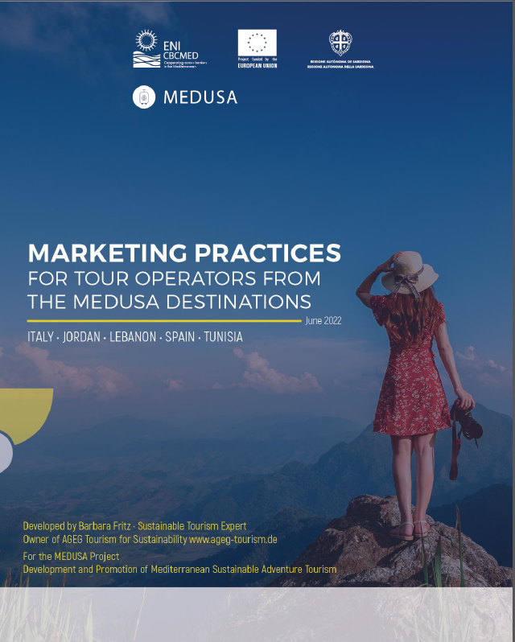
WEBINAR
Background Information for Participants
Handbook on Marketing Practices
Selection of marketing platforms
Good practice examples
Marketing and branding guidelines
Marketing Events
& Power Point Presentations will be send out to participants by next week!
Notes:
You will find selected marketing practices
You can find further information on sustainable tourism marketing platforms,
Marketing events and fairs
And guidelines and inspiration on how to get to your target market in the marketing handbook that will be provided next week
Bevor we learn more about the Marketing Tools of the Mediterranean Adventures in session 4 I will hand over now to Lina al Kahled from Jordan, the MEDUSA Marketing Coordinator to give us an insight on the newly set up Brand to promote Sustainable Adventure Tourism in the Mediterranean:
The Mediterranean Adventures

